Slide 1

AASD 4016
Full Stack Data Science Systems
Applied AI Solutions Developer Program

Slide 2
Module 4
Docker
Vejey Gandyer

Slide 3
Agenda
Docker
Why Docker
Virtual Environment
Dockerfile
.dockerignore
Build a Docker image
Run a Docker container
Examples

Slide 4
Iris Classifier
Create a Virtual Environment​
Install all libraries​
Create requirements.txt​
Create a Dockerfile​
Create a Docker image​
Create a Docker container​
Test the endpoints within the running Docker container​
Notebook to Script
Script to Flask
Load model and keep it up for inference
Infer from the model
Test the endpoint using Curl, POSTMAN
Build a python web client
Test the client

Slide 5
Current Flask project structure
Project Structure
app.py
helper(s).py [Optional]
templates/
index.html
result.html
static/
Style.css [Optional]

Slide 6
Expected Flask project structure
Project Structure
app.py
helper(s).py [Optional]
templates/
index.html
result.html
static/
Style.css [Optional]
Dockerfile
requirements.txt
iris-venv/

Slide 7
Docker

Slide 8
Dockerizing a web application
Installing Docker
Creating a Virtual environment
Installing necessary libraries
Creating requirements.txt
Creating a Dockerfile
Building a Docker image
Running a Docker container
Testing the endpoints

Slide 9
Virtual Environment
Create a new virtual environment
virtualenv iris-venv -p python3.8
Activate the newly created virtual environment
source iris-venv/bin/activate
deactivate

Slide 10
Installing necessary libraries
Install all libraries
pip install pandas sklearn Flask
Creating requirements.txt
pip freeze -l > requirements.txt

Slide 11
requirements.txt
Creating requirements.txt
pip freeze -l > requirements.txt
click==8.0.1
Flask==2.0.1
itsdangerous==2.0.1
Jinja2==3.0.1
joblib==1.0.1
MarkupSafe==2.0.1
numpy==1.21.1
pandas==1.3.1
python-dateutil==2.8.2​
pytz==2021.1​
scikit-learn==0.24.2​
scipy==1.7.1​
six==1.16.0​
sklearn==0.0​
threadpoolctl==2.2.0​
Werkzeug==2.0.1​

Slide 12
Dockerfile
FROM python:3.8.5
ADD . /app
WORKDIR /app
RUN pip install -r requirements.txt
ENTRYPOINT ["python"]
CMD ["app.py"]

Slide 13
Build docker image
Building a Docker image
docker build –t iris:1.0 .
Sending build context to Docker daemon 345.6MB
Step 1/6 : From python:3.8
---> 42d342fa9773

Slide 14
Build docker image
Collecting MarkupSafe==2.0.1
Downloading MarkupSafe-2.0.1-cp38-cp38-manylinux2010_x86_64.whl (30 kB)
Collecting numpy==1.21.1
Downloading numpy-1.21.1-cp38-cp38-manylinux_2_12_x86_64.manylinux2010_x86_64.whl (15.8 MB)
Collecting pandas==1.3.1
Downloading pandas-1.3.1-cp38-cp38-manylinux_2_17_x86_64.manylinux2014_x86_64.whl (11.7 MB)
Collecting python-dateutil==2.8.2
Downloading python_dateutil-2.8.2-py2.py3-none-any.whl (247 kB)
Collecting pytz==2021.1
Downloading pytz-2021.1-py2.py3-none-any.whl (510 kB)
Collecting scikit-learn==0.24.2
Downloading scikit_learn-0.24.2-cp38-cp38-manylinux2010_x86_64.whl (24.9 MB)
Collecting scipy==1.7.1
Downloading scipy-1.7.1-cp38-cp38-manylinux_2_5_x86_64.manylinux1_x86_64.whl (28.4 MB)
Collecting six==1.16.0
Downloading six-1.16.0-py2.py3-none-any.whl (11 kB)
Collecting sklearn==0.0
Downloading sklearn-0.0.tar.gz (1.1 kB)
Collecting threadpoolctl==2.2.0
Downloading threadpoolctl-2.2.0-py3-none-any.whl (12 kB)
Collecting Werkzeug==2.0.1
Downloading Werkzeug-2.0.1-py3-none-any.whl (288 kB)
Building wheels for collected packages: sklearn
Building wheel for sklearn (setup.py): started
Building wheel for sklearn (setup.py): finished with status 'done'
Created wheel for sklearn: filename=sklearn-0.0-py2.py3-none-any.whl size=1316 sha256=d8493593d1247e1a8e514ef41b0a87e79cbe47477c88397406af13760e784424
Stored in directory: /root/.cache/pip/wheels/22/0b/40/fd3f795caaa1fb4c6cb738bc1f56100be1e57da95849bfc897
Successfully built sklearn
Installing collected packages: numpy, threadpoolctl, six, scipy, MarkupSafe, joblib, Werkzeug, scikit-learn, pytz, python-dateutil, Jinja2, itsdangerous, click, sklearn, pandas, Flask
Successfully installed Flask-2.0.1 Jinja2-3.0.1 MarkupSafe-2.0.1 Werkzeug-2.0.1 click-8.0.1 itsdangerous-2.0.1 joblib-1.0.1 numpy-1.21.1 pandas-1.3.1 python-dateutil-2.8.2 pytz-2021.1 scikit-learn-0.24.2 scipy-1.7.1 six-1.16.0 sklearn-0.0 threadpoolctl-2.2.0
Removing intermediate container c05766dfee41
---> d73b0c5557eb
Step 5/6 : ENTRYPOINT ["python"]
---> Running in 720e69ce7d1b
Removing intermediate container 720e69ce7d1b
---> 4ea3ba2257b2
Step 6/6 : CMD ["app.py"]
---> Running in 3771137b8938
Removing intermediate container 3771137b8938
---> def36c7facef
Successfully built def36c7facef
Successfully tagged iris:1.0
Sending build context to Docker daemon 345.6MB
Step 1/6 : From python:3.8
---> 42d342fa9773
Step 2/6 : ADD . /app
---> 71124d1c0444
Step 3/6 : WORKDIR /app
---> Running in cbb0584cb001
Removing intermediate container cbb0584cb001
---> 7612619ec6ab
Step 4/6 : RUN pip install -r requirements.txt
---> Running in 1f8d962449d7
Collecting click==8.0.1
Downloading click-8.0.1-py3-none-any.whl (97 kB)
Collecting Flask==2.0.1
Downloading Flask-2.0.1-py3-none-any.whl (94 kB)
Collecting itsdangerous==2.0.1
Downloading itsdangerous-2.0.1-py3-none-any.whl (18 kB)
Collecting Jinja2==3.0.1
Downloading Jinja2-3.0.1-py3-none-any.whl (133 kB)
Collecting joblib==1.0.1
Downloading joblib-1.0.1-py3-none-any.whl (303 kB)

Slide 15
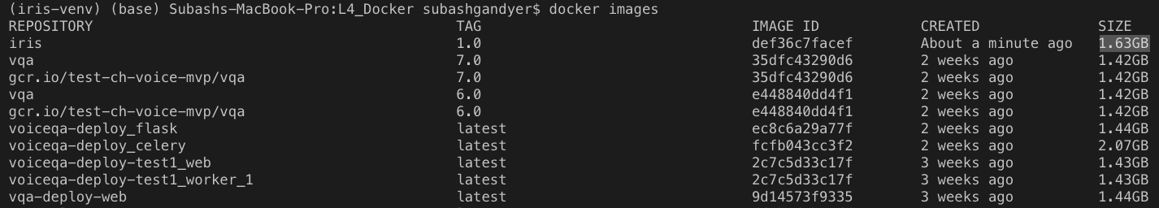
View docker image
Viewing Docker images in your machine
docker images

Slide 16
dockerignore
.dockerignore
iris-venv
.vscode

Slide 17
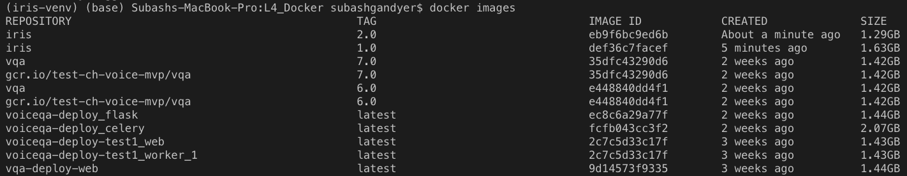
Build another docker image
Building a Docker image
docker build –t iris:2.0 .
Sending build context to Docker daemon 48.13kB
Step 1/6 : From python:3.8
---> 42d342fa9773

Slide 18
Slimmer Dockerfile
FROM python:3.8-slim
ADD . /app
WORKDIR /app
RUN pip install -r requirements.txt
ENTRYPOINT ["python"]
CMD ["app.py"]

Slide 19
Build slimmer docker image
Building a Docker image
docker build –t iris:3.0 .
Sending build context to Docker daemon 48.13kB
Step 1/6 : From python:3.8-slim
---> 42d342fa9773

Slide 20
Run the slimmer docker image
Running a Docker image
docker run –-name iris –p 5000:5000 iris:3.0
* Serving Flask app 'app' (lazy loading)
* Environment: production
WARNING: This is a development server. Do not use it in a production deployment.
Use a production WSGI server instead.
* Debug mode: on
* Running on all addresses.
WARNING: This is a development server. Do not use it in a production deployment.
* Running on http://172.17.0.3:5000/ (Press CTRL+C to quit)
* Restarting with stat
* Debugger is active!
* Debugger PIN: 251-657-431

Slide 21
View docker containers
Viewing Docker containers in your machine
docker ps

Slide 22
Testing the docker container endpoints
Curl
POSTMAN
Python Web Client in browser

Slide 23
Curl Calls
curl http://localhost:5000/train
curl http://localhost:5000/
curl http://localhost:5000/final_classifier?sepalLength=5.1&sepalWidth=3.2&petalLength=3.5&petalWidth=4.2

Slide 24
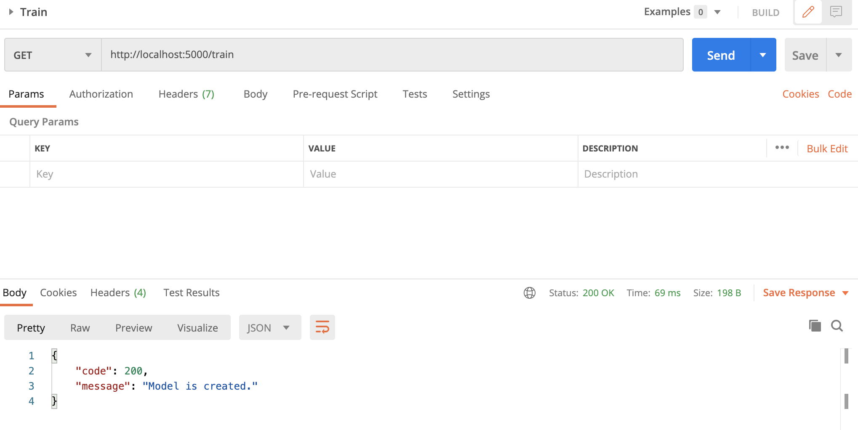
POSTMAN – train a model

Slide 25
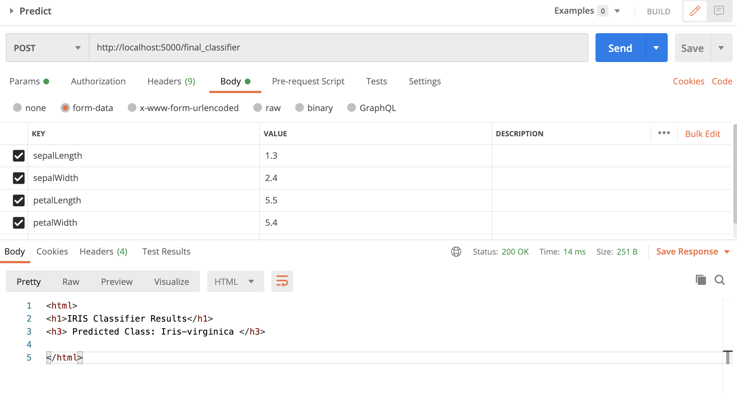
POSTMAN – classify a sample

Slide 26
Test with Python Web Client
Naviagate to
http://localhost:5000/train
Then,
http://localhost:5000/
Input the values within all fields
Click Classify button

Slide 27
Further Reading
Flask Tutorial
https://flask.palletsprojects.com/en/2.0.x/tutorial/
Docker Tutorial
https://www.docker.com

